Slide 1
Product Introduction of Sugon S640-G20
Storage product division

Slide 2
Contents
1
The Introduction of Storage Server Market
2
Introduction of S640-G20 product
3
Introduction of S640-G20 product features
4
Product competitive analysis of S640-G20
Notes:
先讲整个IT行业的大背景

Slide 3
The market of storage server
Large amount of data (PB);storing data online or nearly line;need large storage capacity
Data usually needs to be processed, having certain requirements for computing capacity of the system
For not high requirements of data reliability, the data can be obtained or multi-copies
Need to improve server room installed density and lower overall TCO users

Slide 4
The analysis of storage server for industry application
互联网云盘
视频网站存储节点
共有云盘运营支撑平台
视频网站，IPTV
视频推流服务器
内容分发服务器
高密度存储节点
云存储高密度节点
定制化软、硬一体集成设备
高端NVR服务器
备份一体机
大数据高密度节点
The Internet Cloud disk
Video websites storage Node
Shared cloud disk operation support platform
Video Websites, IPTV
Video flow server
Content delivery serve
High Density Storage Nodes
Cloud storage high density Nodes
Big data high density Nodes
Customized Soft /Hard Integration Equipment
High-end NVR Server
ESTOR

Slide 5
Contents
1
The Introduction of Storage Server Market
2
Introduction of S640-G20 product
3
Introduction of S640-G20 product features
4
Product competitive analysis of S640-G20
Notes:
先讲整个IT行业的大背景

Slide 6
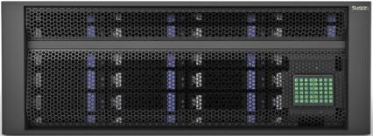
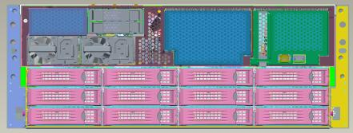
Product Introduction of S640-G20
Standard | Description
Storage Capacity | Maximum 216TB Supporting maximum 24/36pcs 3.5inch hard disk + 4pcs 2.5 inch hard disk
Processor | Two way Intel Xeon E5-2600 v3 series
Chipset | Intel C610
Memory | 24 pcs DIMM slot, support maximum 1.5 TB cache
Network Controller | Two I350 gigabit Ethernet port
Store Controller | 12Gbps SAS controller or 12Gbps SAS Raid controller is optional
Extension | Support maximum 8 pcs PCI-E Gen3
Monitoring Management | Motherboard Integrated BMC module ，supporting IPMI2.0、SNMP v3 and KVM over IP， Disk status LED display
Case Dimensions | 4U，standard rack type 176mm x 432mm x 886mm

Slide 7
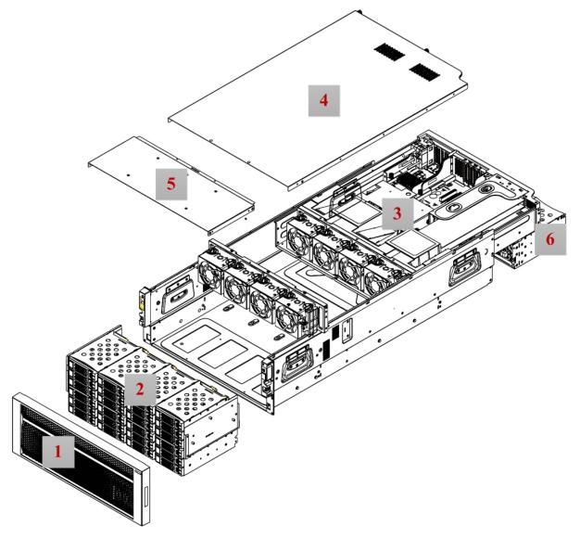
Introduction of Product Module Tray
Chassis front panel
Front hard disk tray
Mainboard tray
Top cover of chassis
Hard disk tray top cover
Rear hard disk tray

Slide 8
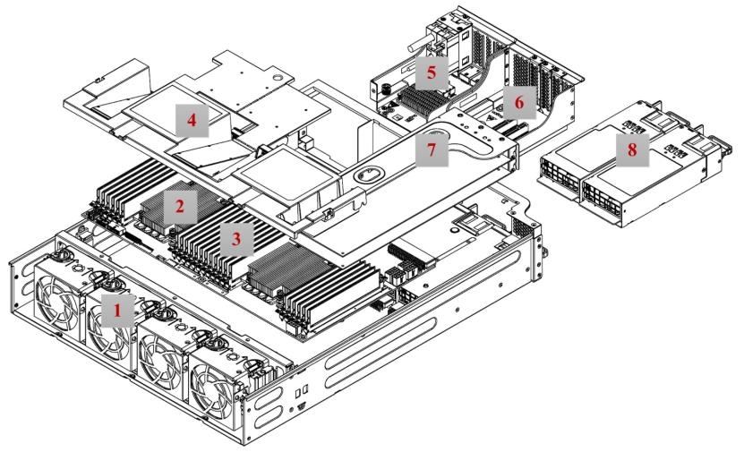
Introduction of Mainboard
Central chassis fan 2. CPU heat sink 3. Memory slot 4. wind scooper 5. Right I/O extension module 6. Left I/O extension module 7. Right Riser module 8. Redundant power supply

Slide 9
Contents
1
The Introduction of Storage Server Market
2
Introduction of S640-G20 product
3
Introduction of S640-G20 product features
4
Product competitive analysis of S640-G20
Notes:
先讲整个IT行业的大背景

Slide 10
S650G20 Product Features
Mass Storage
Capacity
High Performance
3
High Reliability
2
4
S650G20
1
5
Manageability
Low CTO

Slide 11
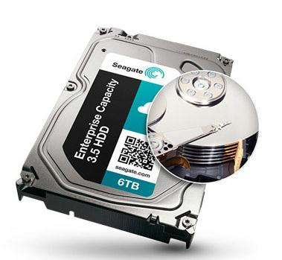
Compatible with the latest 6 TB hard disk, providing mass storage capacity
36
×
Single system storage capacity maximum 216 TB!!!!!!

Slide 12
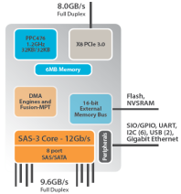
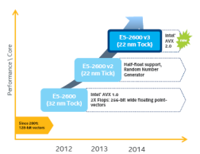
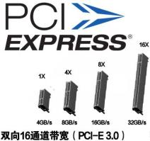
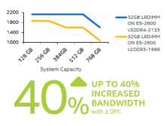
Upgraded Architecture making the system performance improve
12Gb/s SAS Technology
Haswell Processor Architecture
High performance
PCIe 3.0
DDR4 Memory Technology

Slide 13
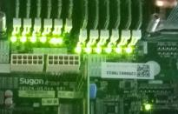
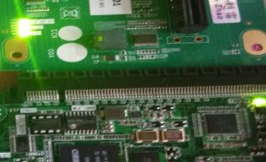
Star light diagnosis, easy to maintain
The machine with a total of 60 monitoring signals, including the comprehensive monitoring for CPU, memory, Riser expansion card, the power signal,，every part of the system in-place, working state.

Slide 14
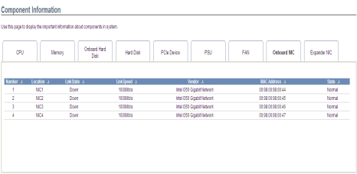
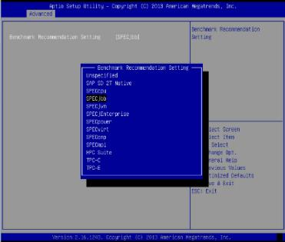
Rich management functions,
performance optimization, one-click seting
BMC support SD card equipment log storage, and can save system information unlimited
BMC monitoring
Sugon R&D management module（BMC）independent，support IPMI2.0 ， SNMP，Independent management port ，support SOL,CLI,KVM over IP，Support remote upgrade BIOS/Firmware
BMC can realize the monitoring on parts consumption and limit the machine power consumption;
Can remote update a BIOS FW By BMC Web that’s a convenient and humanistic upgrade strategy
The first time implementation monitoring of card key information by BMC ， contains the manufacturer, type, speed, link state, MAC address,and the correspondence between the MAC and NIC；
set the optimal configuration of
Benchmark test on one click

Slide 15
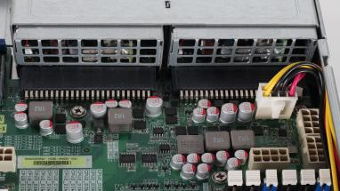
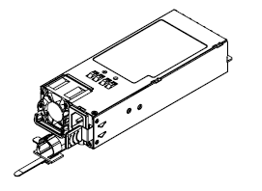
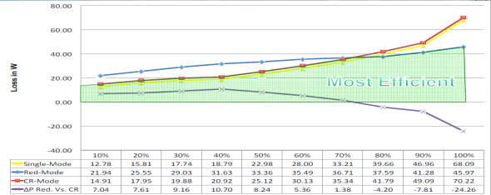
Platinum CRPS power supply，Green energy-saving
CRPS Power Supply
Power DIP Board, with no cable routing, seems more artistic and better cooling effect
Support power cold backup：
Incold standby mode, the power conversion efficiency can be increased 3% again, up to 95%.
Multiple contact sensors：
The machine system containing 25 sensors to ensure the machine heat noise effect balanced

Slide 16
Provide custom services at different
levels to meet customer demand
Simple logo
customization
Structure appearancecustomization
Packaging, labels, BIOS and BMC interface logo
customization
According to user requirements and combining with Sugon product to customize, including product specifications, the server internal structure, product appearance.
Simple
简单
According to the customer business characteristics，customize by the solution of binding the customer application with Sugon hard and soft product to improve the TCO of system.
Require to customize management functions for customer on BMC management chip, the BIOS etc.
复杂
Complex
Solutions business customization
Function set
customization

Slide 17
Contents
1
The Introduction of Storage Server Market
2
Introduction of S640-G20 product
3
Introduction of S640-G20 product features
4
Product competitive analysis of S640-G20
Notes:
先讲整个IT行业的大背景

Slide 18
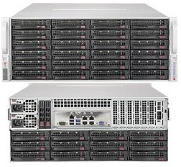
Competition analysis：SMC Storage Server
Product mode | SugonS640-G20 | SMC 24/36
CPU | dualE5-2600 v3 | dualE5-2600 v3
Memory | 24 pcs DDR4 2133/ 1866 ECC memory | 8/24 slotDDR4
Height | 4U | 4U
Store Controller | 12G SAS and SAS RAID | 12G SAS and SAS RAID
2.5 inch hard disk | 4 | 2
The number of 3.5 -inch hard disk | 24/36（6TB） | 24/36
The integrated network port | 2x1GbE | 2x1Gb
PCI-Eextension | 8 pcs PCI-E Gen3 | 4 pcs PCI-E Gen3
Case Dimensions (mm) | 176 x 432 x 886 | 178 × 437 × 699
Other features | Support NVDIMM,PCI-E SSD
Sugon vs SMC
Product Advantage
Support rear 4 sets hotplug system disk.SMC only support 2 set
More PCIe slots.S640 - the G20 maximum 8 PCIe slots, can match more high-speed network card and IB card
Support NVDIMM.S640 - the G20 configurable NVDIMM to ensure that the memory data when the power outage.
Light diagnosis functionS640 - the G20 with more than 60 signal in system to monitor the state of CPU, memory, fan and other core components
Easy maintenance. S640 - the G20 support all travel guide.
SMC型号：
6048R-E1CR24N
6048R-E1CR36N
5048R-E1CR36L

Slide 19
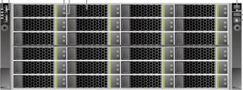
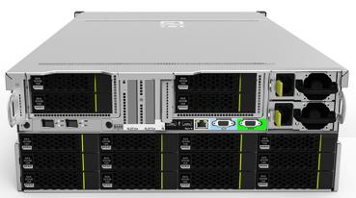
Competition analysis ：5288 V3
Product mode | SugonS640-G20 | Huawei5288 V3
CPU | dualE5-2600 v3 | dualE5-2600 v3
Memory | 24 pcs DDR4 2133/ 1866 ECC memory | 16 pcs DDR4
Height | 4U | 4U
Store Controller | 12G SAS and SAS RAID | 6Gb SAS and SAS RAID
2.5 inch hard disk | 4 | 4
The number of 3.5 -inch hard disk | 24/36（6TB） | 24/36
The integrated network port | 2x1GbE | 2x1GbE/4x1GbE
PCI-Eextension | 8 pcs PCI-E Gen3 | 6 pcs PCI-E X8 + 1个PCI-EX4
Case Dimensions (mm) | 176mm x 432mm x 886mm | 175 × 447 × 748
Sugon vs Huawei
Product Advantage
Larger memory capacity.S640-G20 support 24 DIMM slot, more than 5288v3
More PCIe S640-G20 support maximum eight PCIe slots, rear support only six
Support NVDIMM.S640 - the G20 configurable NVDIMM to ensure that the memory data when the power outage
Light diagnosis functionS640 - the G20 with more than 60 signal in system to monitor the state of CPU, memory, fan and other core components

Slide 20
Competition analysis ：
Product mode | SugonS640-G20 | InspurSA5224L2
CPU | Dual E5-2600 v3 | SingleE3-1200
Memory | 24 pcs DDR4 2133/ 1866 ECC内存 | 4 pcs DDR3
Height | 4U | 4U
Store Controller | 12G SAS and SAS RAID | 6G SAS and SAS RAID
2.5 inch hard disk | 4 | 2
The number of 3.5 -inch hard disk | 24/36（6TB） | 24
The integrated network port | 2x1GbE | 2x1Gb
PCI-Eextension | 8个PCI-E Gen3 | 4个PCI-E Gen3
Case Dimensions (mm) | 176x 432 x 88 | 178 × 437 × 699
Other features | Support NVDIMM,PCI-E SSD
Sugon vs Inspur
Product Advantage
Higher CPU performance. The latter is single way server products
Support rear four sets hotplug system disk。The latter only supports two system disk
More PCIe slots.S640 - G20 maximum eight PCIe slots, can match more high-speed network card and IB card
BMCmanagement function. S640-the G20 adopted their own management module, ， the function supported more than Inspur/SMC storage server products
Light diagnosis functionS640 - the G20 with more than 60 signal in system to monitor the state of CPU, memory, fan and other core components
All Inspur24/36 disk storage server OEM SMC product！！！

Slide 21
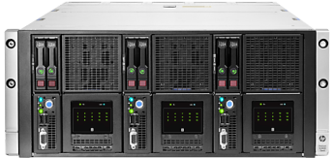
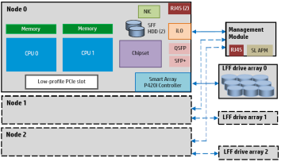
Competition analysis ：HP SL4500
Product mode | SugonS640-G20 | HP SL4500
CPU | Dual E5-2600 v3 | Dual E5-2400 v2
Memory | 24 pcs DDR4 2133/ 1866 ECC内存 | 12 pcs DDR2 1033 ECC内存
Height | 4U | 4.3U
Store Controller | 12G SAS和SAS RAID | 6Gb SAS和 SAS RAID
2.5 inch hard disk | 4 | 6
The number of 3.5 -inch hard disk | 24/36（6TB） | 60（4TB）
The integrated network port | 2x1GbE | 2x1GbE + 2x10GbE
PCI-Eextension | 8 pcs PCI-E Gen3 | 1 pcs PCI-E x8
Case Dimensions (mm) | 176 x 432 x 886 | 189 x 443 x 890
Othe | Support NVDIMM,PCI-E SSD | 可扩展为2-3节点
Sugon vs HP
Product Advantage
Higher CPU performance. The latter is the last generation CPU architecture products
Larger memory capacity.Larger memory capacity.S640-G20 support 24 DIMM slot, more than SL4500
More PCIe slots.S640-G20 maximum eight PCIe slots, can match more high-speed network card and IB card
The system has high reliability。The latter power down in user ，system reliability is poor.
Light diagnosis function.S640 - the G20 with more than 60 signal in system to monitor the state of CPU, memory, fan and other core components

